Slide 1
Data Presentation
Marketing Analytics Project

Slide 2
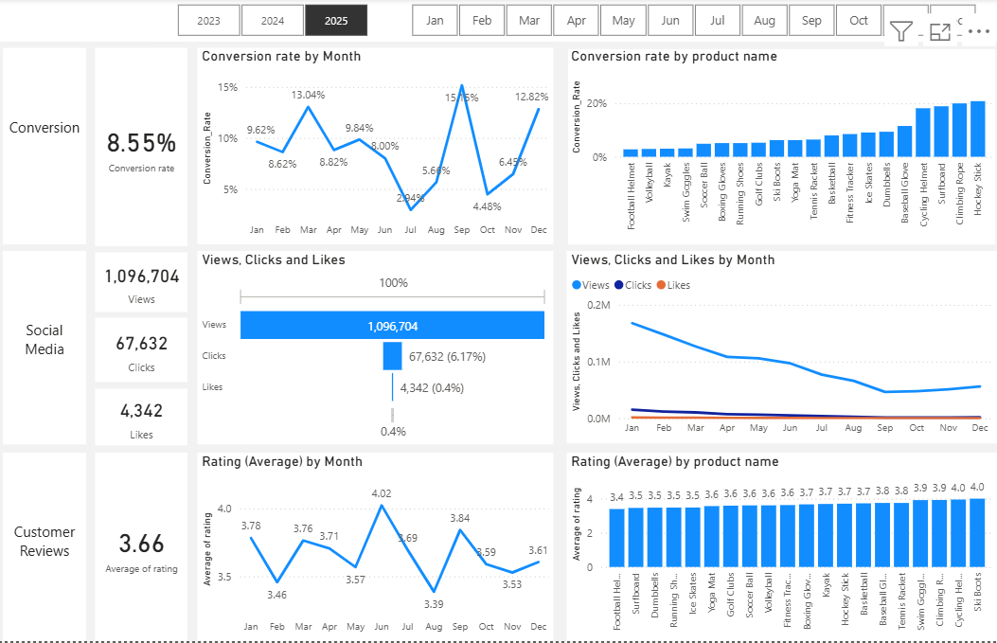
Overview
Decreased Conversion Rates: The conversion rate demonstrated a strong rebound in December, reaching 12.82%, despite a notable dip to 4.48% in October.
Reduced Customer Engagement:
There is a decline in overall social media engagement, with views dropping throughout the year.
While clicks and likes are low compared to views, the click-through rate stands at 6.17%, meaning that engaged users are still interacting effectively.
Customer Feedback Analysis:
Customer ratings have remained consistent, averaging around 3.66 throughout the year.
Although stable, the average rating is below the target of 4.0, suggesting a need for focused improvements in customer satisfaction, for products below 3,5.

Slide 3
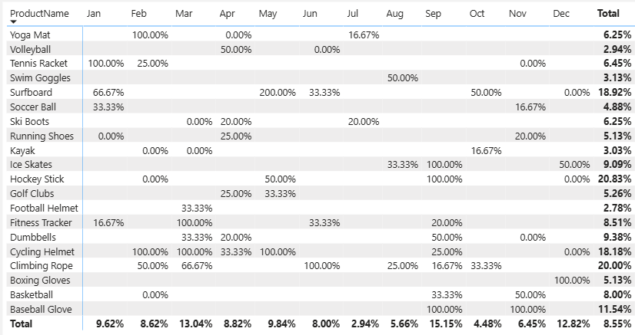
Decreased Conversion Rates
General Conversion Trend:
Throughout the year, conversion rates varied, with higher numbers of products converting successfully in months like March and December. This suggests that while some products had strong seasonal peaks, there is potential to improve conversions in lower-performing months through targeted interventions.
Lowest Conversion Month:
July experienced the lowest overall conversion rate at 2.94%, with no products standing out significantly in terms of conversion. This indicates a potential need to revisit marketing strategies or promotions during this period to boost performance.
Highest Conversion Rates:
September recorded the highest overall conversion rate at 15.15%, driven significantly by the Ice Skates, Hockey Stick and Baseball Glove with a remarkable 100% conversion. This indicates strong early seasonal demand supported by effective marketing strategies that successfully attracted high-intent customers, particularly for sports-related products.

Slide 4
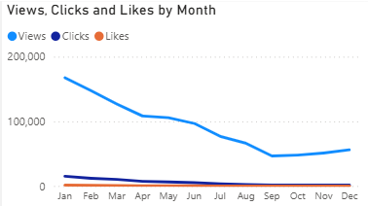
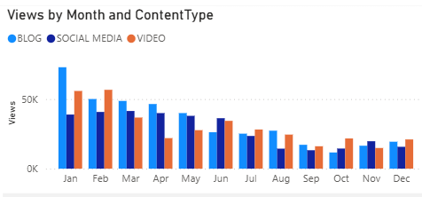
Reduced Customer Engagement
Declining Views:
The peak in views during January followed by a sharp decline indicates a reduction in audience engagement, possibly due to post-holiday seasonality or decreased marketing activity.
Low Interaction Rates:
Clicks and likes remained consistently low compared to views, suggesting the need for more engaging content or stronger calls to action.
Content Type Performance:
Blog content generated the highest number of views, particularly in January, while social media and video content remained relatively stable in the first half of the year before gradually declining toward the end of the year.

Slide 5
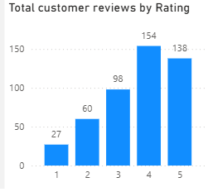
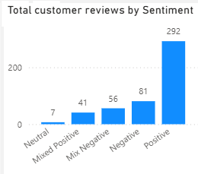
Customer Feedback Analysis
Customer Ratings Distribution:
The majority of customer reviews are in the higher ratings, with 154 reviews at 4 stars and 138 reviews at 5 stars, indicating overall positive feedback. Lower ratings (1-2 stars) account for a smaller proportion, with 27 reviews at 1 star and 60 reviews at 2 stars.
Sentiment Analysis:
Positive sentiment dominates with 292 reviews, reflecting a generally satisfied customer base. Negative sentiment is present in 81 reviews, with a smaller number of mixed and neutral sentiments, suggesting some areas for improvement but overall strong customer approval.
Opportunity for Improvement:
The presence of mixed positive and mixed negative sentiments suggests that there are opportunities to convert those mixed experiences into more clearly positive ones, potentially boosting overall ratings. Addressing the specific concerns in mixed reviews could elevate customer satisfaction.

